Slide 1

"Decoding MMA: An In-depth Analysis"
Exploring Fight outcomes through Fighters and Locations

Slide 2



Table of Contents
1
Introduction to MMA
2
Project Overview
3
Data Accumulation
4
Data Analysis
5
Project Learnings

Slide 3
Introduction To MMA
MMA (Mixed Martial Arts) is a dynamic and exciting combat sport.
It combines various techniques and fighting styles, making it one of the most versatile combat sports in the world.
MMA bouts take place inside an octagonal cage or ring.
The sport has gained immense popularity globally and features a wide range of weight classes.
MMA fighters are known for their discipline, athleticism, and adaptability in the cage.
MMA offers intense action, making it a must-watch sport for combat sports enthusiasts

Slide 4
Project Overview
Data Collection: Gathering MMA fight data from reliable sources.
Data Preparation: Cleaning and structuring data for analysis.
AWS Integration: Hosting MySQL database on AWS for team collaboration.
SQL Analysis: Extracting meaningful insights from the data.
PowerBI Visualization: Creating insights and reports.
Team Collaboration: Utilizing AWS to share work efficiently over the cloud.

Slide 5
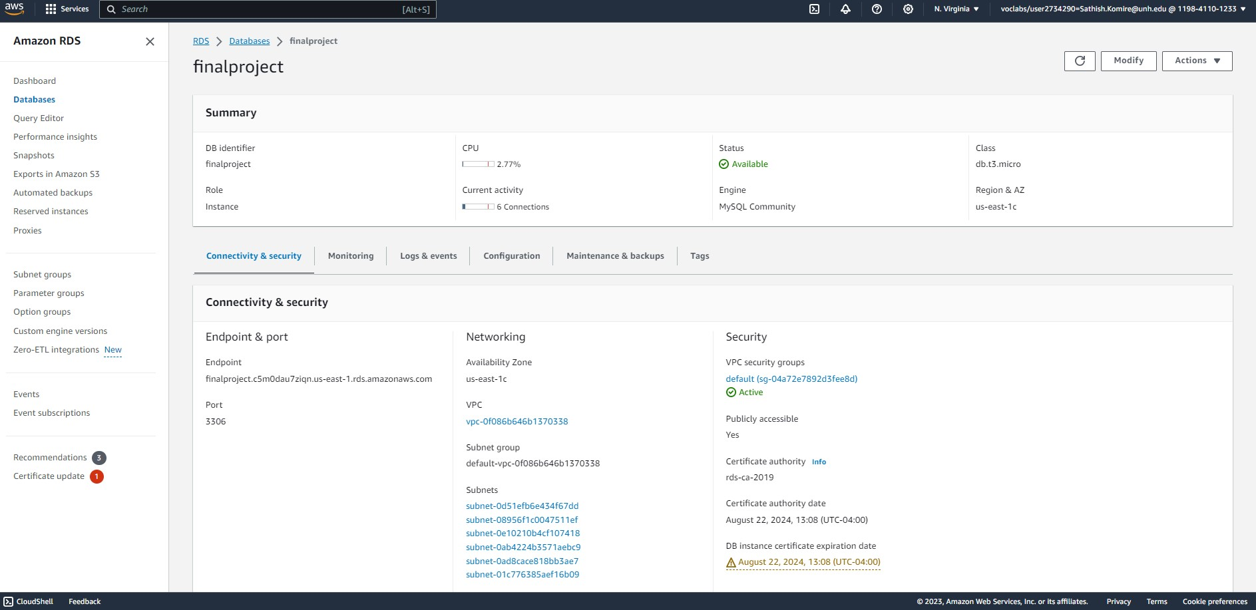
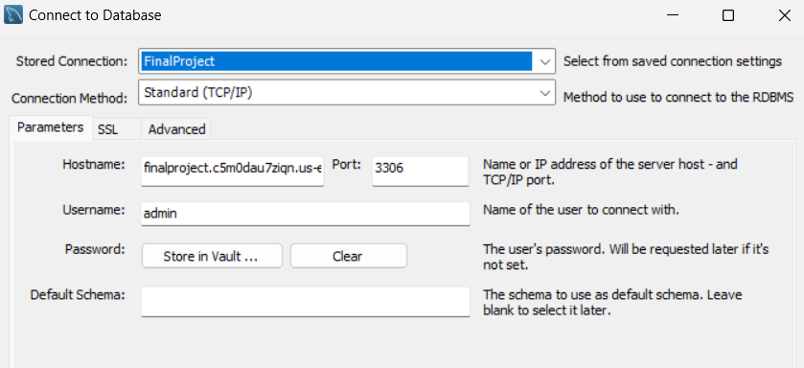
Database SETUP

Slide 6
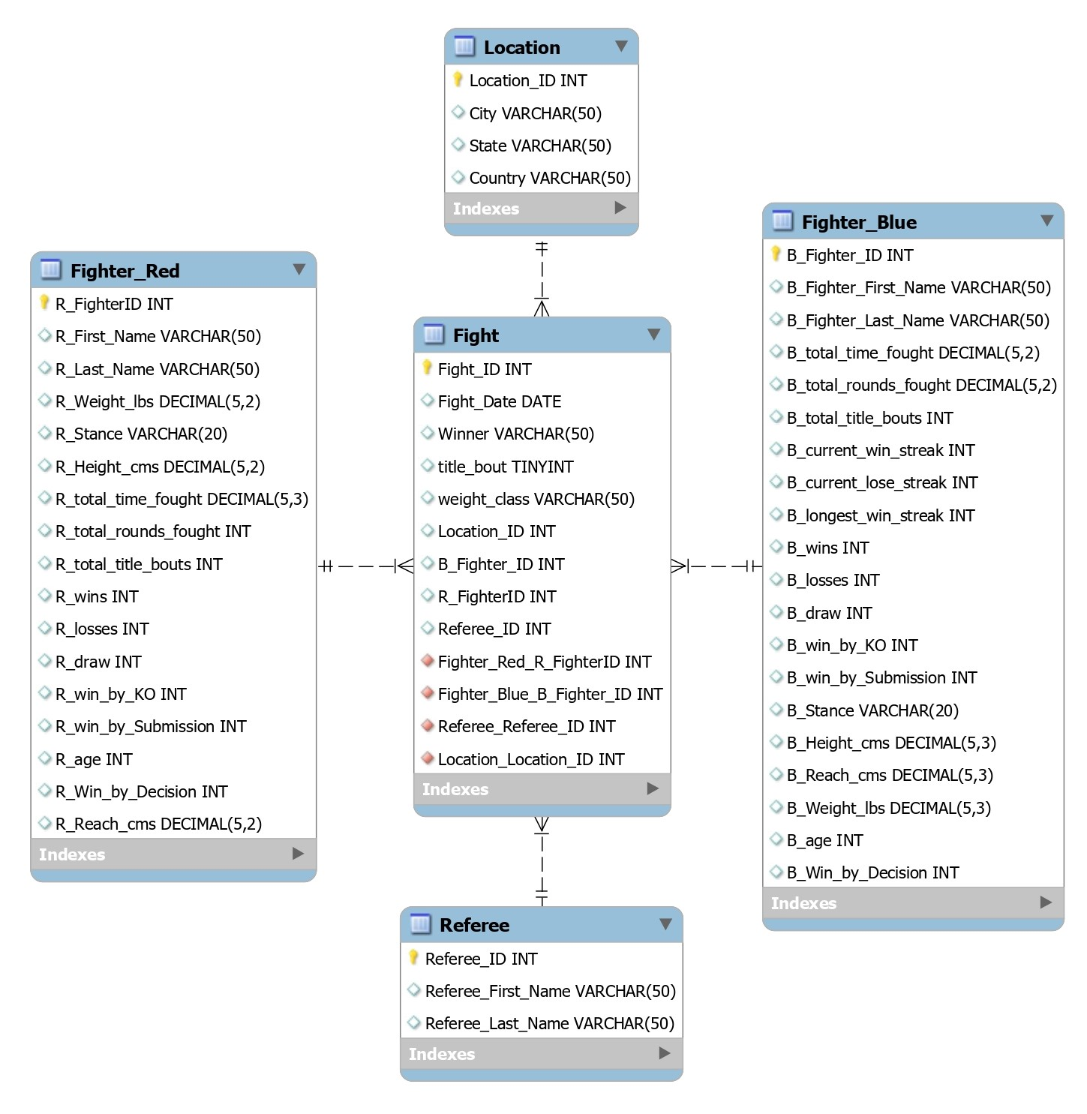




ERD
This is the ERD representation of our Normalized Dataset
This is based on Star Schema where Fight Entity is the Fact Table, and the remaining tables are Dimension Tables
All relationships are non- identifying due to independence

Slide 7
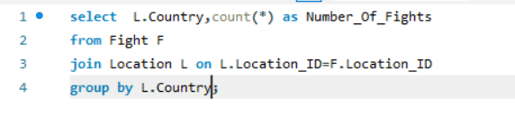

Fights by Country

Slide 8
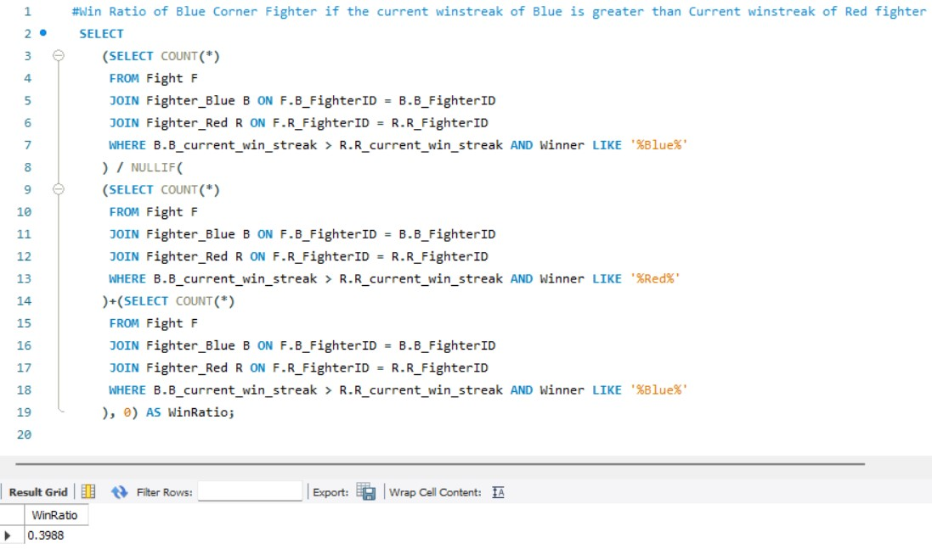
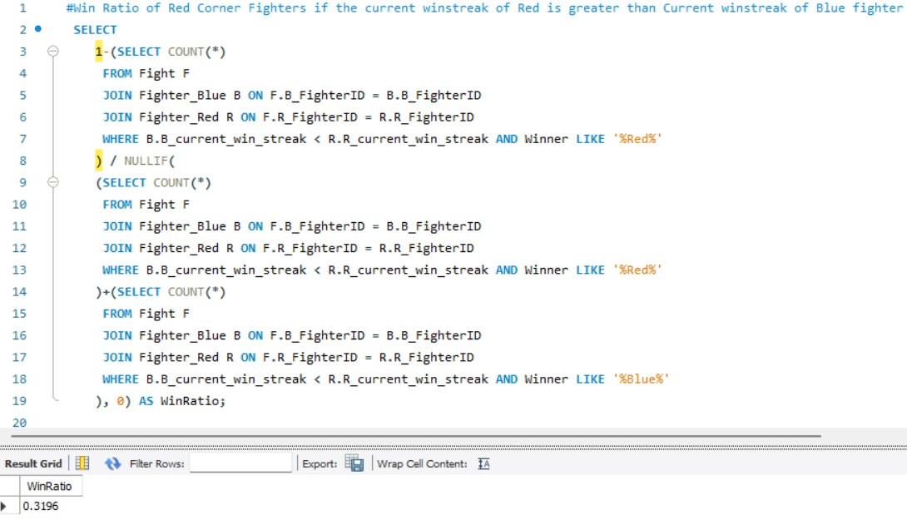
Win ratio of blue and red corner fighter

Slide 9
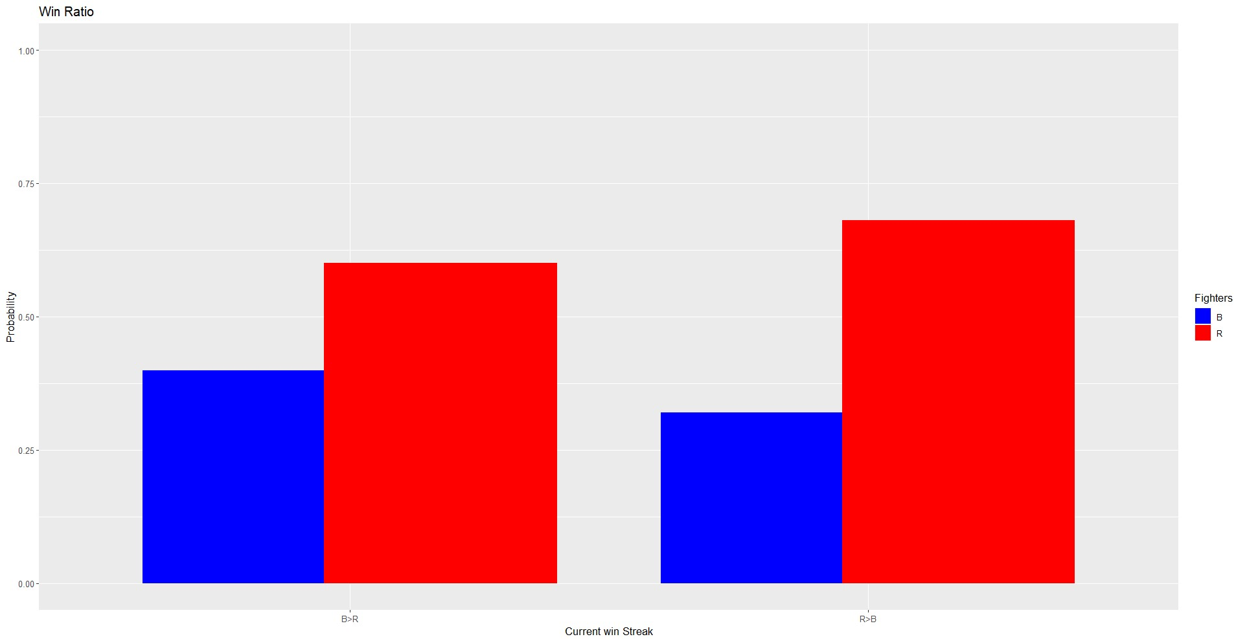
Visualization

Slide 10
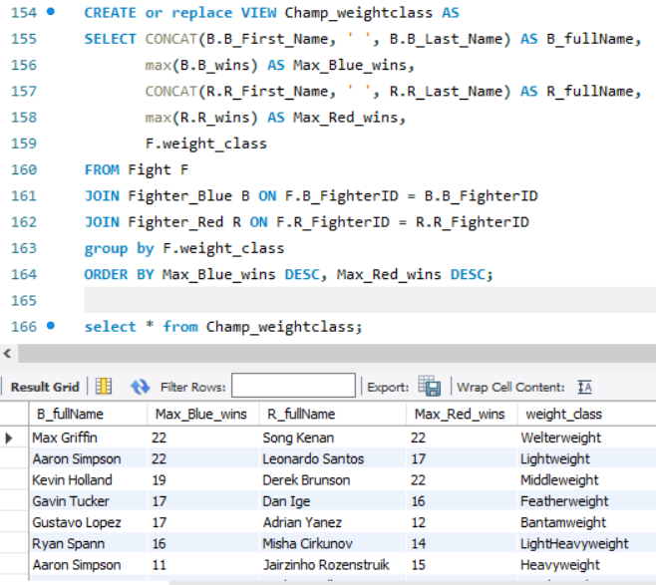
Champion by weight class

Slide 11
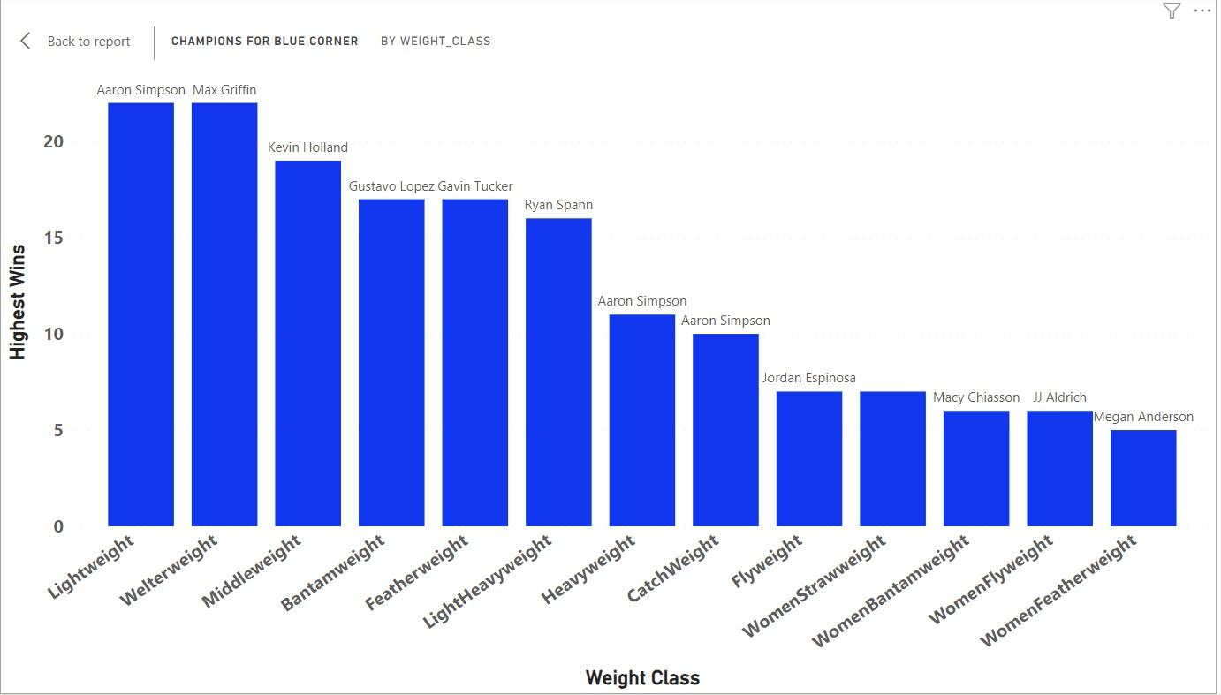
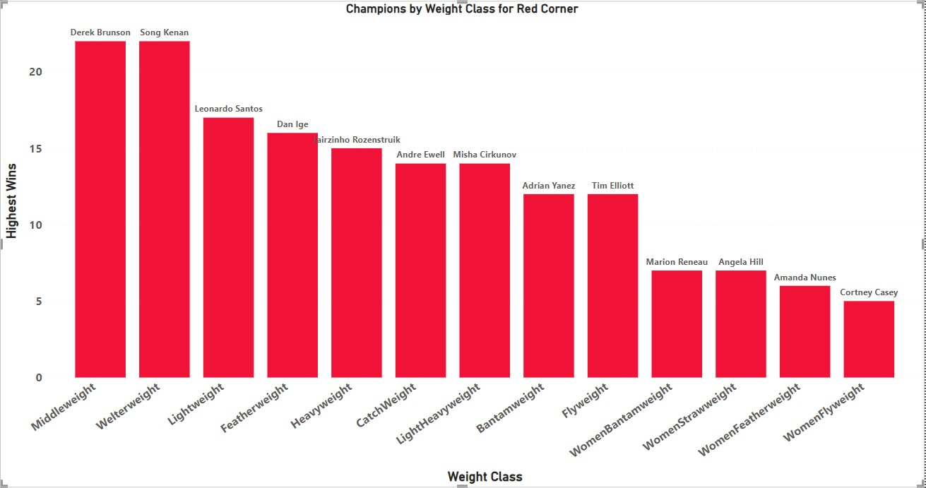
Visualization

Slide 12
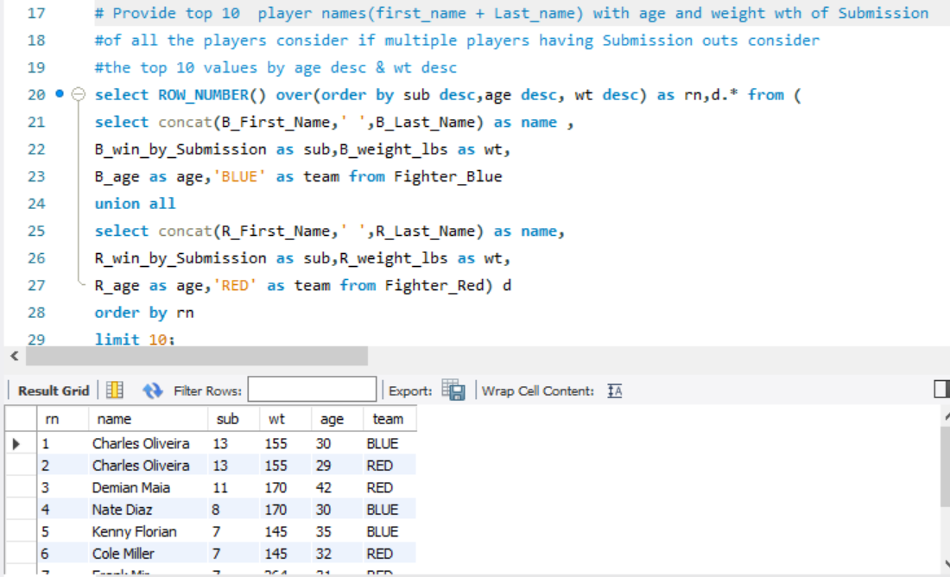
Champions by Submission

Slide 13
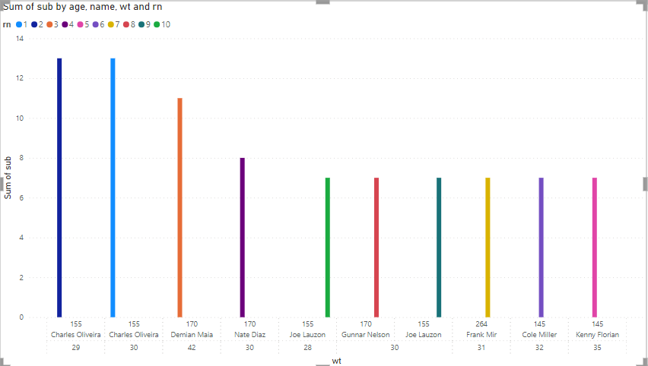
Visualization

Slide 14
Challenges
Relevant data sourcing and formatting given the overwhelming number of datasets available online
Data Integrity checks during normalization of the original dataset to suit our project analyses
Forgetting that the tables are in sync and trying to do operations without informing in a shared space
Time Management and meeting organization according to available schedules (constraints such as part time commitments, internships, academic schedule)

Slide 15
Learning Outcomes
Data Interpretation & Visualization: Acquired skills in analyzing fight data, recognizing trends, and displaying important metrics with different tools.
Statistical Proficiency: Improved skills in using statistics to study fighters' results and make predictions about future matches.
Domain Knowledge: Gained knowledge about MMA factors like fighter position and weight category and how they affect match results.
Database Querying: Became skilled in using SQL to handle MMA data, offering insights into weight categories, fighter comparisons, and trends based on location.

Slide 16

"Knockout Thanks!"

Slide 17
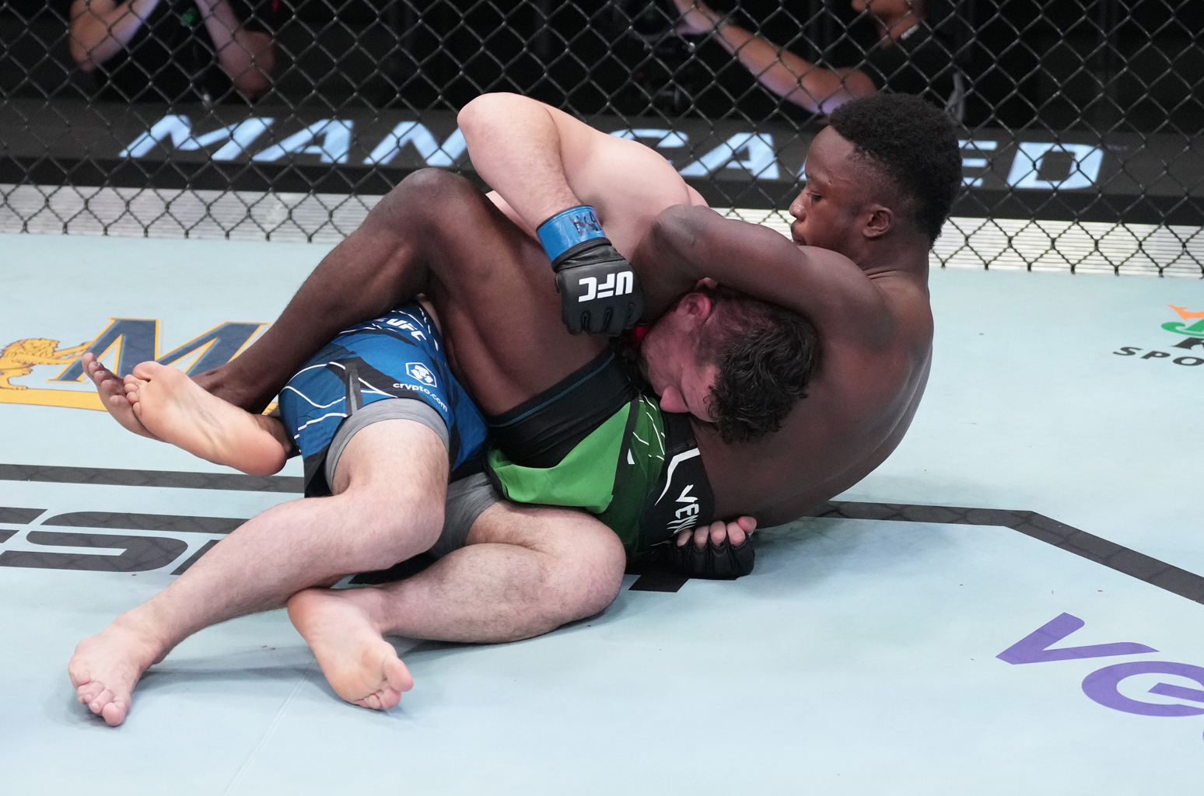
QQ
Q&A?

